Slide 1
Public Health Schools and School Travel Team present…
Ways to help you smile
The Smile Book
A project for EYFS children which aims to:
Improve well-being
Protect mental health
Increase emotional resilience

Slide 2
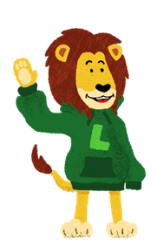
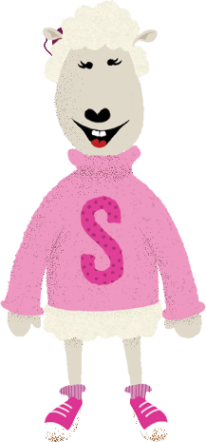
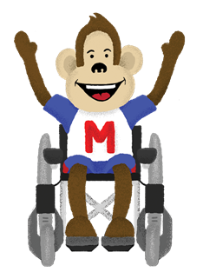
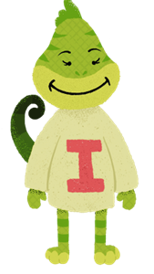
“Sometimes we’re happy and sometimes we’re sad It’s OK if you feel this way There are plenty of ways to take care of your mind You could find out from your friends today"
www.brighton-hove.gov.uk/smile-project

Slide 3
How do you take care of your body?
How do you take care of your mind?

Slide 4
Lesson 1
We are learning:
to notice how we are feeling
to talk about our feelings
that no problem is too big or too small that we can’t get help
that talking with our friends and family can help to make us feel happy and well

Slide 5
How can we make sure we feel safe and valued in these lessons?
Join in
Listen carefully to others
It’s ok to have different ideas
It’s ok to take part in different ways

Slide 6
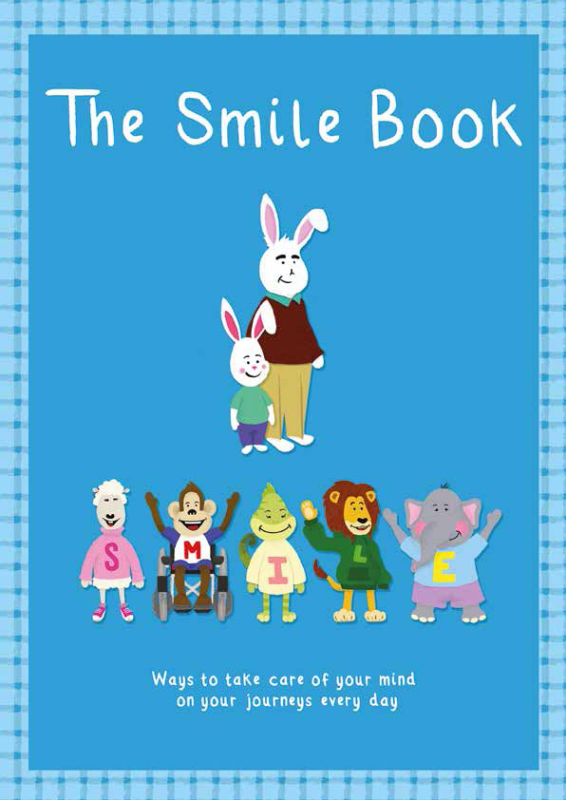
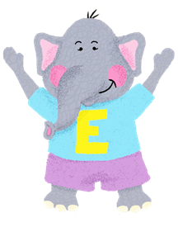
Read ‘The Smile Book’.
Ravi and friends are teaching us that sometimes we feel happy and sometimes we feel sad and that’s ok.
If we notice and practise these things we can learn to look after our minds.
Say and sign each one to help you to remember them.
S is for Speak and Sign
M is for Moving
I is Imagining
L is for Learning
E is Enjoying

Slide 7
What does Suzie do to help take care of her mind?
Speaking and signing about our feelings can help us to feel better.
Speaking and signing helps our friendships to grow.

Slide 8
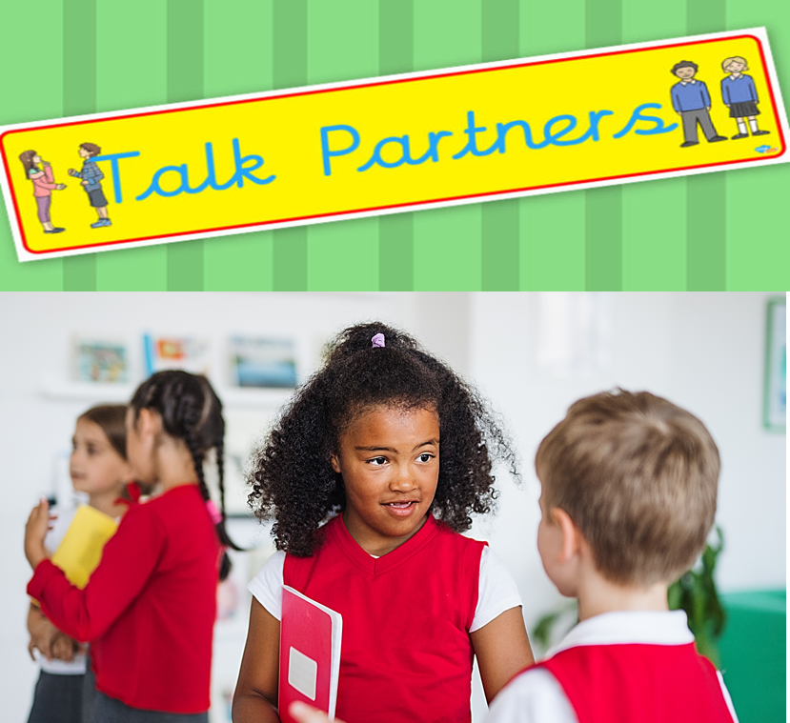
What different feelings or emotions can we think of?
Which of these feelings do we find difficult?

Slide 9
Draw or write on the giant emojis. What can make someone feel sad or cross?
Tell each other about your ideas.
What might help them to feel better?

Slide 10
Speaking and signing about our feelings and problems can help us to solve them. Remember, no problems are too big or too small for us to talk about them.

Slide 11
Speaking and signing about happy times can remind us of what we enjoy too.
Talk to your partner about the best thing that happened today. You can tell your grown-ups on the way home from school too.

Slide 12
Lesson 2
We are learning:
to notice how moving makes us feel good
that exercise is good for our bodies and our minds and can help to make us feel happy and well

Slide 13
How can we make sure we feel safe and valued in these lessons?
Join in
Listen carefully to others
It’s ok to have different ideas
It’s ok to take part in different ways

Slide 14
Read ‘The Smile Book’.
Ravi and friends are teaching us that sometimes we feel happy and sometimes we feel sad and that’s ok.
If we notice and practise these things we can learn to look after our minds.
Say and sign each one to help you to remember them.
S is for Speak and Sign
M is for Moving
I is Imagining
L is for Learning
E is Enjoying

Slide 15
How does Mickey take care of his mind?
Moving helps us to be fit and healthy.
Moving helps us to feel happy and well.

Slide 16
Have a go at this exercise or your favourite ‘fit kids’ routine…
https://www.youtube.com/watch?v=KhfkYzUwYFk&list=PLx6NI1J7QxpM6VMvaJCXhPg-AWSMhFvv8&index=1

Slide 17
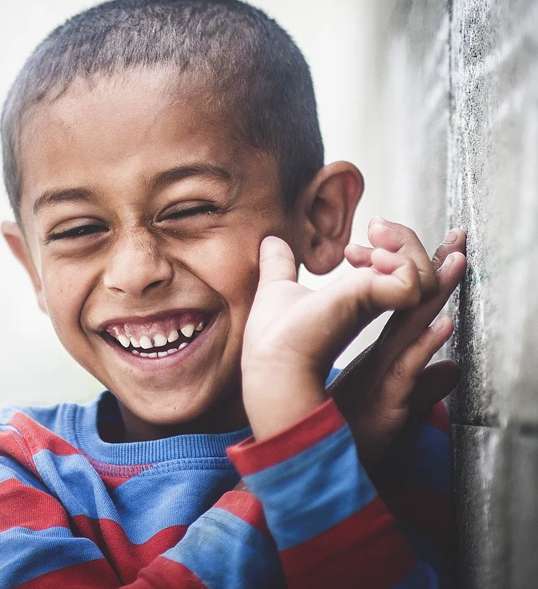
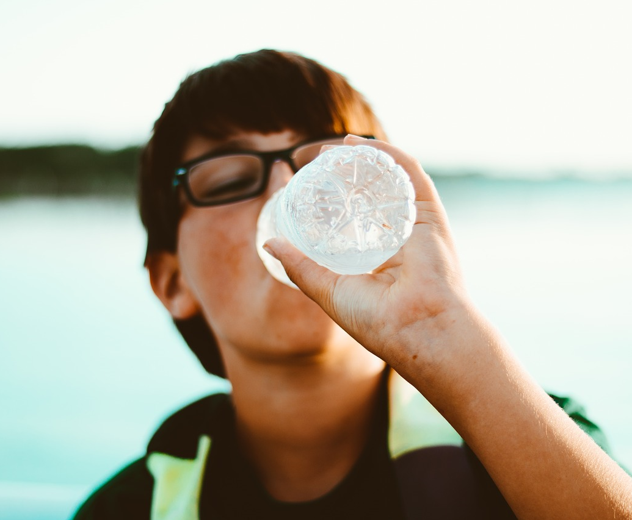
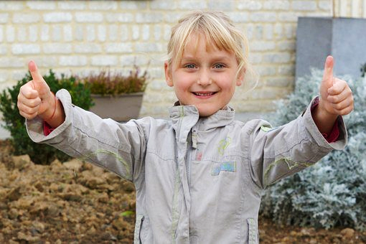
How are you feeling now?
How does your body feel?
How is your mood?

Slide 18
What is your favourite way to exercise?

Slide 19
Find a fun way to exercise on your way home. You could run, skip or jump with your grown-ups all the way along the road. You could try out as many silly walks as you can think of.

Slide 20
Lesson 3
We are learning:
that imagining helps us to find new ways to play and learn.
that imagining helps our ideas to grow.

Slide 21
How can we make sure we feel safe and valued in these lessons?
Join in
Listen carefully to others
It’s ok to have different ideas
It’s ok to take part in different ways

Slide 22
Read ‘The Smile Book’.
Ravi and friends are teaching us that sometimes we feel happy and sometimes we feel sad and that’s ok.
If we notice and practise these things we can learn to look after our minds.
Say and sign each one to help you to remember them.
S is for Speak and Sign
M is for Moving
I is Imagining
L is for Learning
E is Enjoying

Slide 23
How does Immy take care of her mind?
Imagining helps us to find new ways to play and learn .
Imagining helps our ideas to grow.

Slide 24
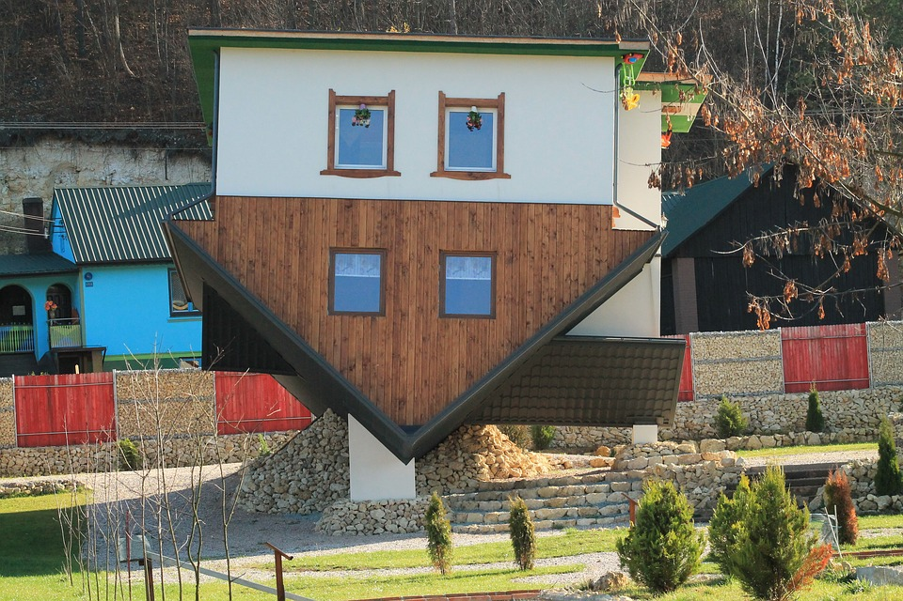
Imagine if…? Can you ask and answer a ‘What if…?’ question about each of these pictures?
Share your ideas.

Slide 25
Find a fun way to imagine on your way home. You could play cloud spotting with your grown-ups. Notice the shapes the clouds are making. What do they remind you of? What could they be?

Slide 26
Lesson 4
We are learning:
that learning new skills helps us feel good about ourselves.
that learning gives us new skills to enjoy.
that we never stop learning.

Slide 27
How can we make sure we feel safe and valued in these lessons?
Join in
Listen carefully to others
It’s ok to have different ideas
It’s ok to take part in different ways

Slide 28
How does Leo take care of his mind?
Learning helps us to feel good about ourselves.
Learning gives us new skills to enjoy.

Slide 29
What new skills are we learning at school? What new skills can Leo learn at home?

Slide 30
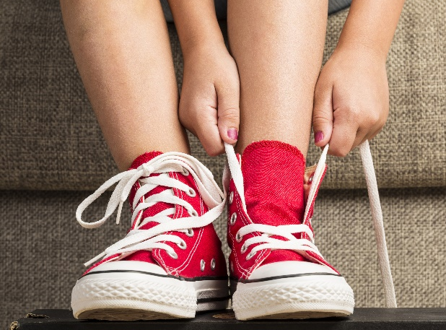
Leo finds it hard to tie his shoe laces. How can we help him?
One step at a time.
Stick at it. Try, try and try again.
Don’t give up.
Watch someone else.
Ask for help.
Remember it’s ok if you still can’t do it.

Slide 31
Let’s try together or you could try at home…
It’s very difficult!
What could we remember
to help us feel ok about
this difficult learning?

Slide 32
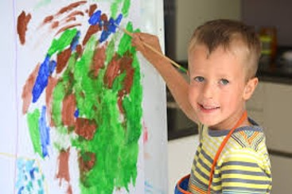
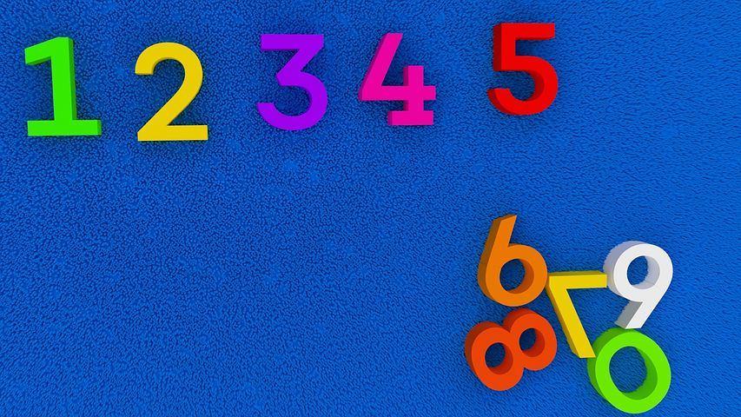
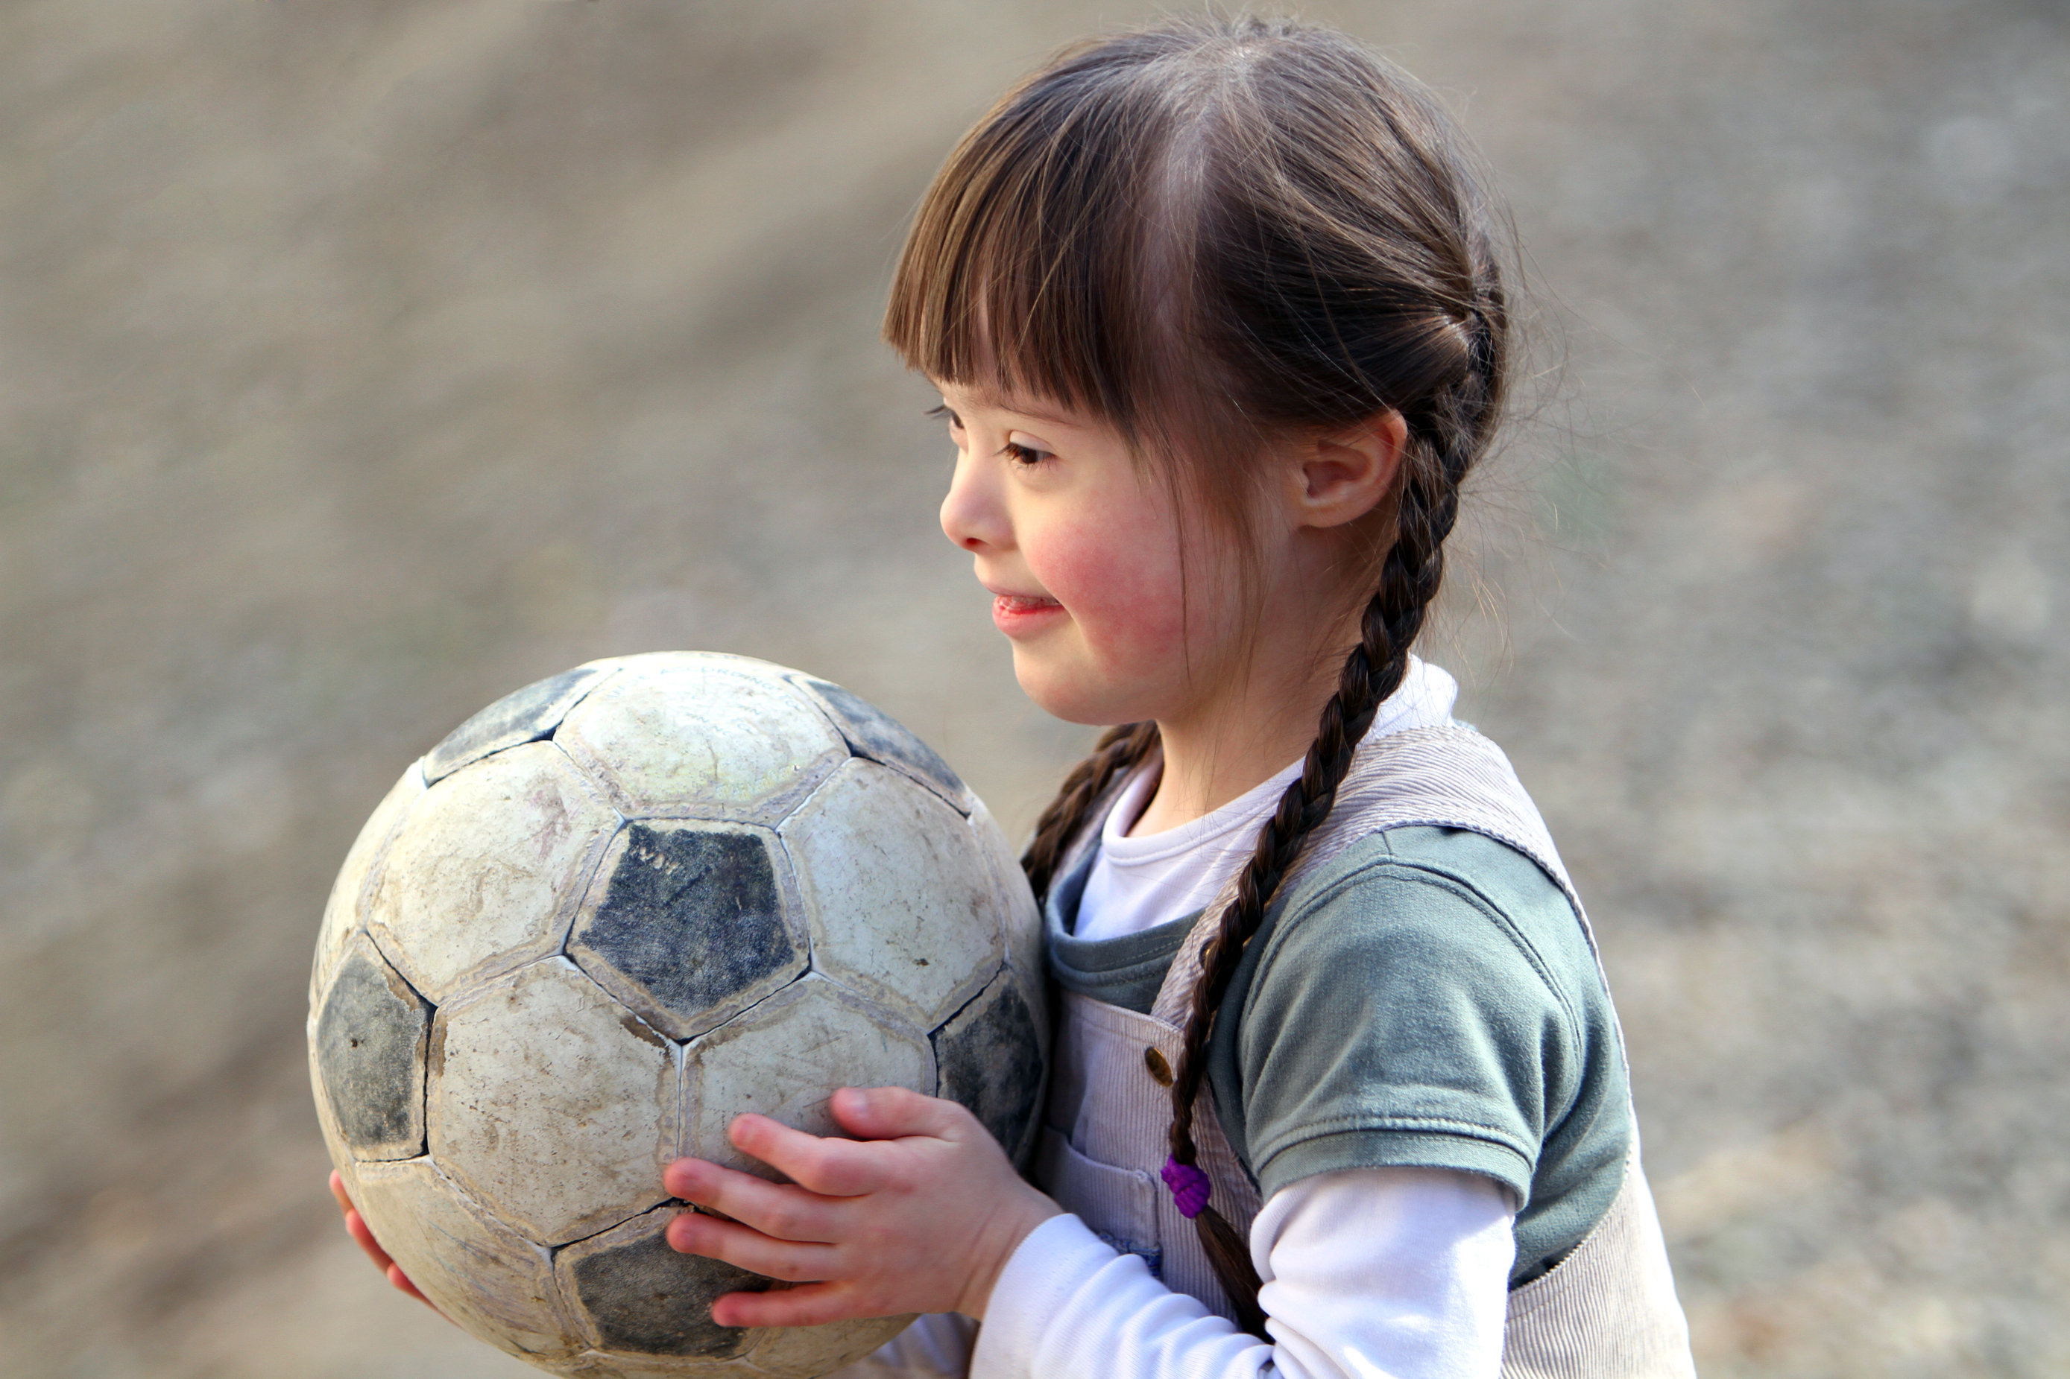
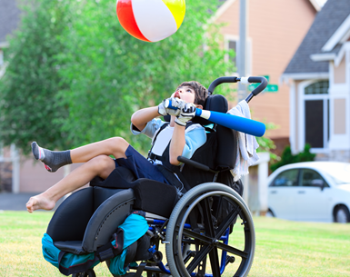
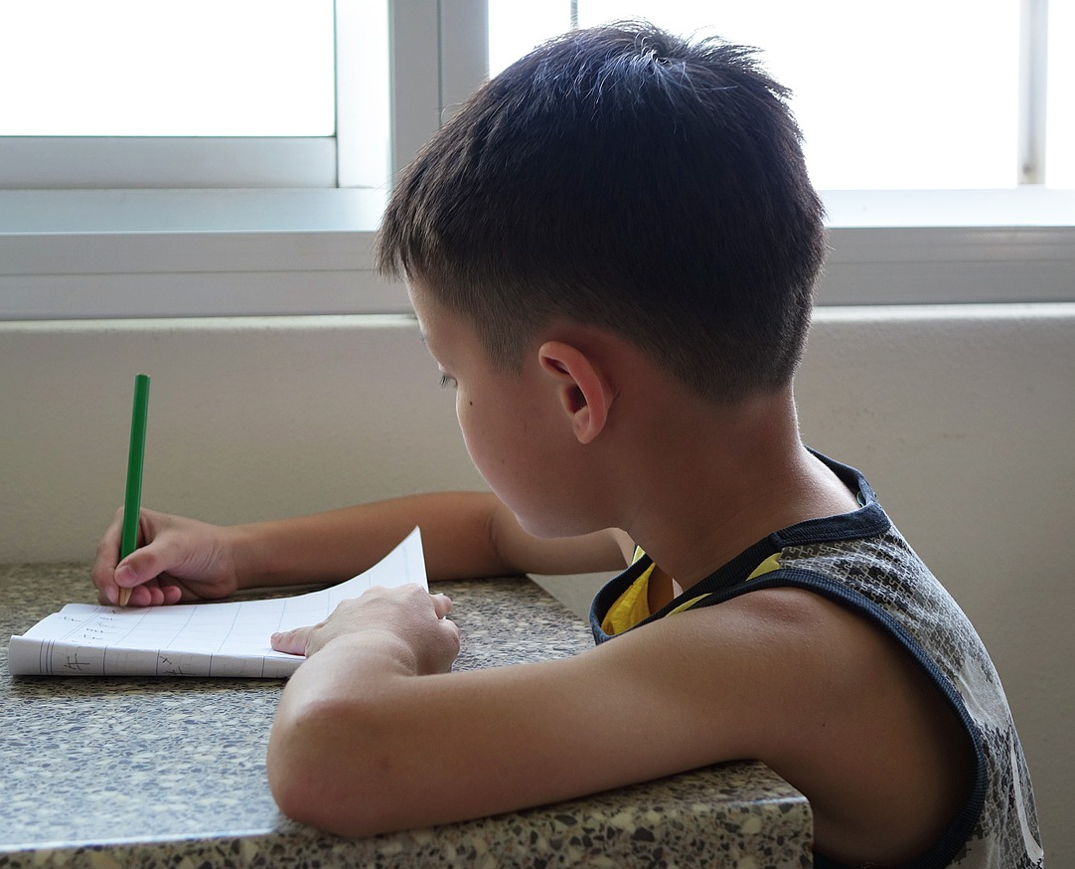
Which of these skills can we do already? How did you feel when you master new skills?
Which of these skills are you still learning?

Slide 33
Practise your learning on your way home from school. You could see how many letter sounds you recognise on signs; or find the biggest door number you can.

Slide 34
Lesson 5
We are learning:
To look out for the things we enjoy
That we can notice and enjoy small things everyday

Slide 35
How can we make sure we feel safe and valued in these lessons?
Join in
Listen carefully to others
It’s ok to have different ideas
It’s ok to take part in different ways

Slide 36
Read ‘The Smile Book’.
Ravi and friends are teaching us that sometimes we feel happy and sometimes we feel sad and that’s ok.
If we notice and practise these things we can learn to look after our minds.
Say and sign each one to help you to remember them.
S is for Speak and Sign
M is for Moving
I is Imagining
L is for Learning
E is Enjoying

Slide 37
How does Elsie take care of her mind?
When we notice what we enjoy, we can do more of those things and feel happy.
Enjoying things is so important for our health.

Slide 38
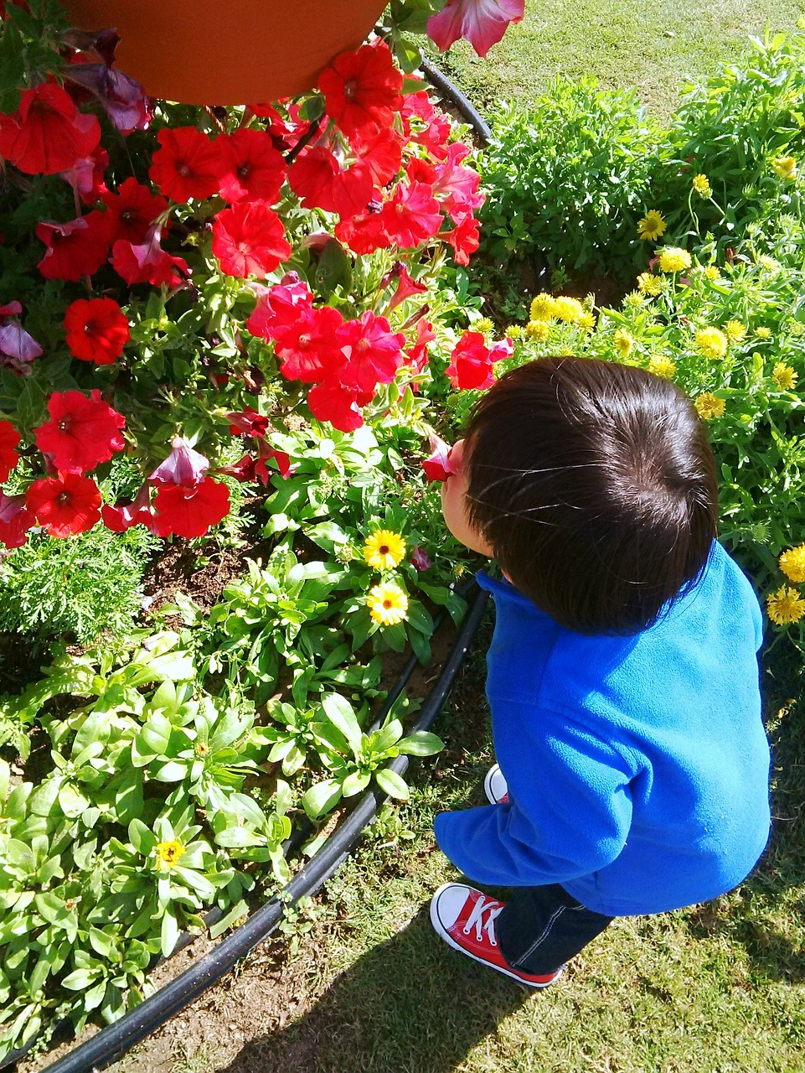
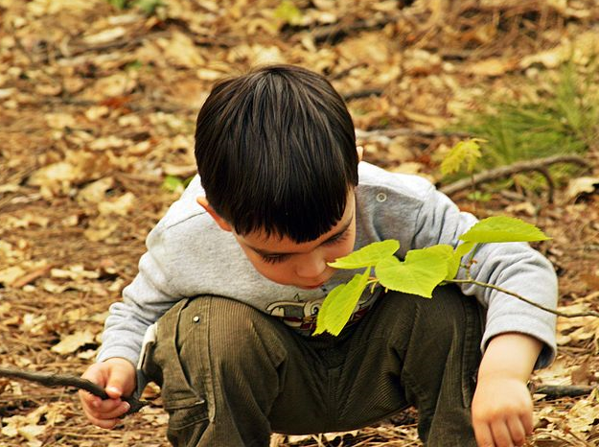
Elsie enjoys going into the outside environment to enjoy using her senses!
Use your noticing skills to find something tiny and beautiful.
Find something brightly coloured or shiny.
Find something soft or spiky.
Listen to the different sounds.
What can you smell?

Slide 39
What did you see, hear, smell, taste and touch?

Slide 40
Elsie says…
When we notice what we are sensing it can make us feel calm and happy.
We can notice beautiful things around us everyday.

Slide 41
Lesson 6
We are learning:
That helping other people smile can help us, and other people, feel good
That helping our friendships to grow helps us to feel happy.

Slide 42
Can you remember what each of Ravi’s friends are teaching us to do?

Slide 43
How does Ravi take care of his mind?
When we help other people smile, we also help other people take care of their minds.
Helping other people smile is important for our own health.

Slide 44
How do you like to help others to smile? Have you made anyone smile today?

Slide 45
How do you take care of your body?
How do you take care of your mind?

